Slide 1
WebXR for Automobile
current status
Abdul Wahab, Mohsin Ali, Hurair Hashmi, Timo Kraus

Slide 2
Agenda
Our Approach
Current Challenges
Milestones
Current State of Development

Slide 3
Our Approach
Development:
Development of four prototypes on our own
Discussion of code and adjustment of goals in regular meetings
Knowledge exchange and continuous improvement
Methodology:
We try to use Kanban and make use of a Trello Board
Code commits in Github repository

Slide 4
Current Challenges
Limited Number of fully supported end-user devices and browsers (few possibilities to test code)
Constant changes on the state of the WebXR Device API (few consistent information sources)
Selection of framework
Approach on 3D object modeling

Slide 5
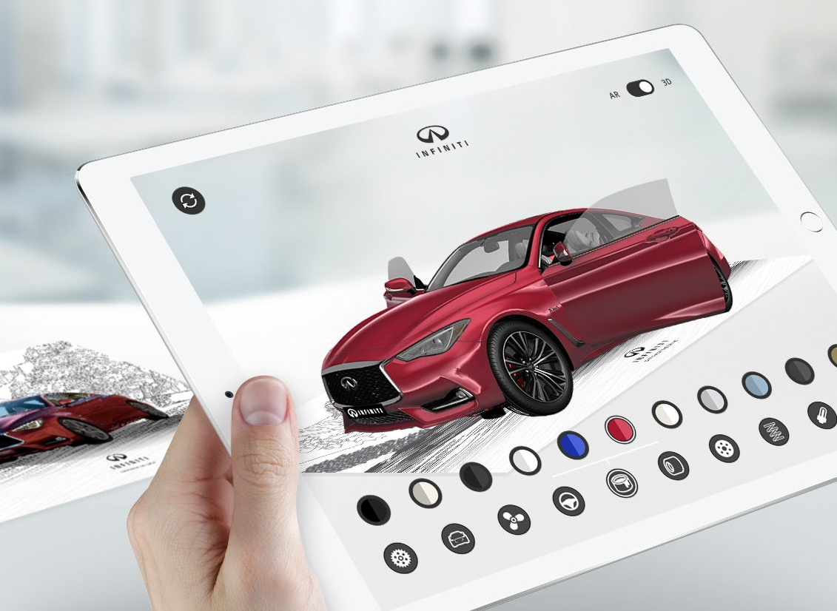
Milestones
Clarify way of working
Definition of Requirements
Landing Page
Working Prototype
Working Solution
Fine Tuning / Refactoring
Documentation

Slide 6
Current State of Development
We are still testing different frameworks and components to see which fits best. Currently we are trying out the following:
AFrame
three.js
AR.js
Unity
WebGL

Slide 7
Quick Demo
https://github.com/7imo/WebXR/

